Slide 1
Osher Lifelong Learning Institute, Fall 2023
Contemporary Economic Policy
American University
Fall, 2023
Jon Haveman, Ph.D.
National Economic Education Delegation

Slide 2
Course Outline
Contemporary Economic Policy
  Week 1 (9/28): US Federal Budget (Jon Haveman, NEED)
  Week 2 (10/5): Trade and Globalization (Arkadiusz Mironko, Indiana Univ. East)
  Week 3 (10/12): International Institutions (Alan Deardorff U of Michigan)
  Week 4 (10/19): Economic Update (Geoffrey Woglom Amherst College)
  Week 5 (10/26): Monetary Policy (Geoffrey Woglom)
  Week 6 (11/02): Intro to Financial Economics(Geoffrey Woglom)

Slide 3
Submitting Questions
Please submit questions in the chat.
  I will try to handle them as they come up, but may take them in a bunch as time permits.
We will do a verbal Q&A once the material has been presented.
  And the questions in the chat have been addressed.
OLLI allowing, we can stay beyond the end of class to have further discussion.

Slide 4
Credits and Disclaimer
This slide deck was authored by:
  Peter Eppinger, University of Tübingen
  James Lake, Southern Methodist University
  Michael Plouffe, University College London
  Swati Verma, ISID, New Delhi
This slide deck was reviewed by:
  Alan Deardorff, University of Michigan
  Ed Leamer, UCLA
Disclaimer
  NEED presentations are designed to be nonpartisan.
  It is, however, inevitable that the presenter will be asked for and will provide their own views.
  Such views are those of the presenter and not necessarily those of the National Economic Education Delegation (NEED).

Slide 5
Outline
What is Globalization?
Pros and Cons of Trade
Trade Policies
The Role of Trade Agreements
(Effects of the Pandemic and War)

Slide 6
What Globalization is
Growth over time of many interactions between countries
  Trade
  Global Value Chains
  Foreign Direct Investment
  Financial Flows
  International Travel
  Migration
  Telecommunications and transportation
I will focus here on trade

Slide 7
Trade

Slide 8

Notes:
Our World in Data
https://ourworldindata.org/trade-and-globalization

Slide 9

Notes:
Our World in Data
https://ourworldindata.org/trade-and-globalization

Slide 10
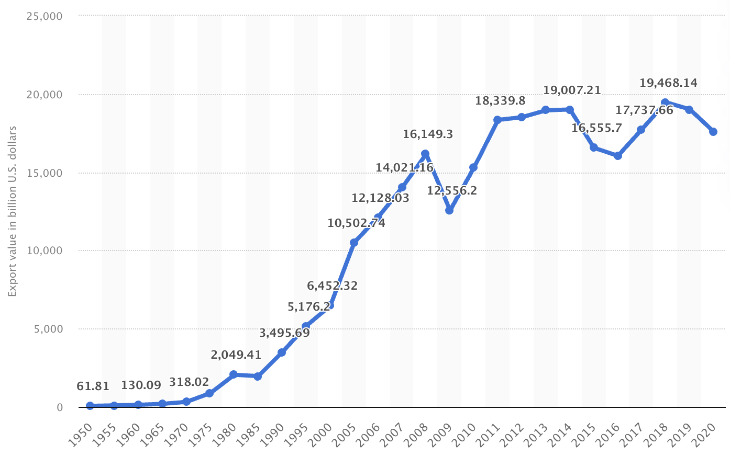
Export Volume Worldwide in Billions of US Dollars, 1950-2020
Source: Statista
Notes:
Statista
https://www.statista.com/statistics/264682/worldwide-export-volume-in-the-trade-since-1950/

Slide 11
Global Value Chains

Slide 12
Effects on Economies
Supply Chains
  Globalization has created long and complex international supply chains
  Pandemic and the war in Ukraine complicated them even more

Slide 13
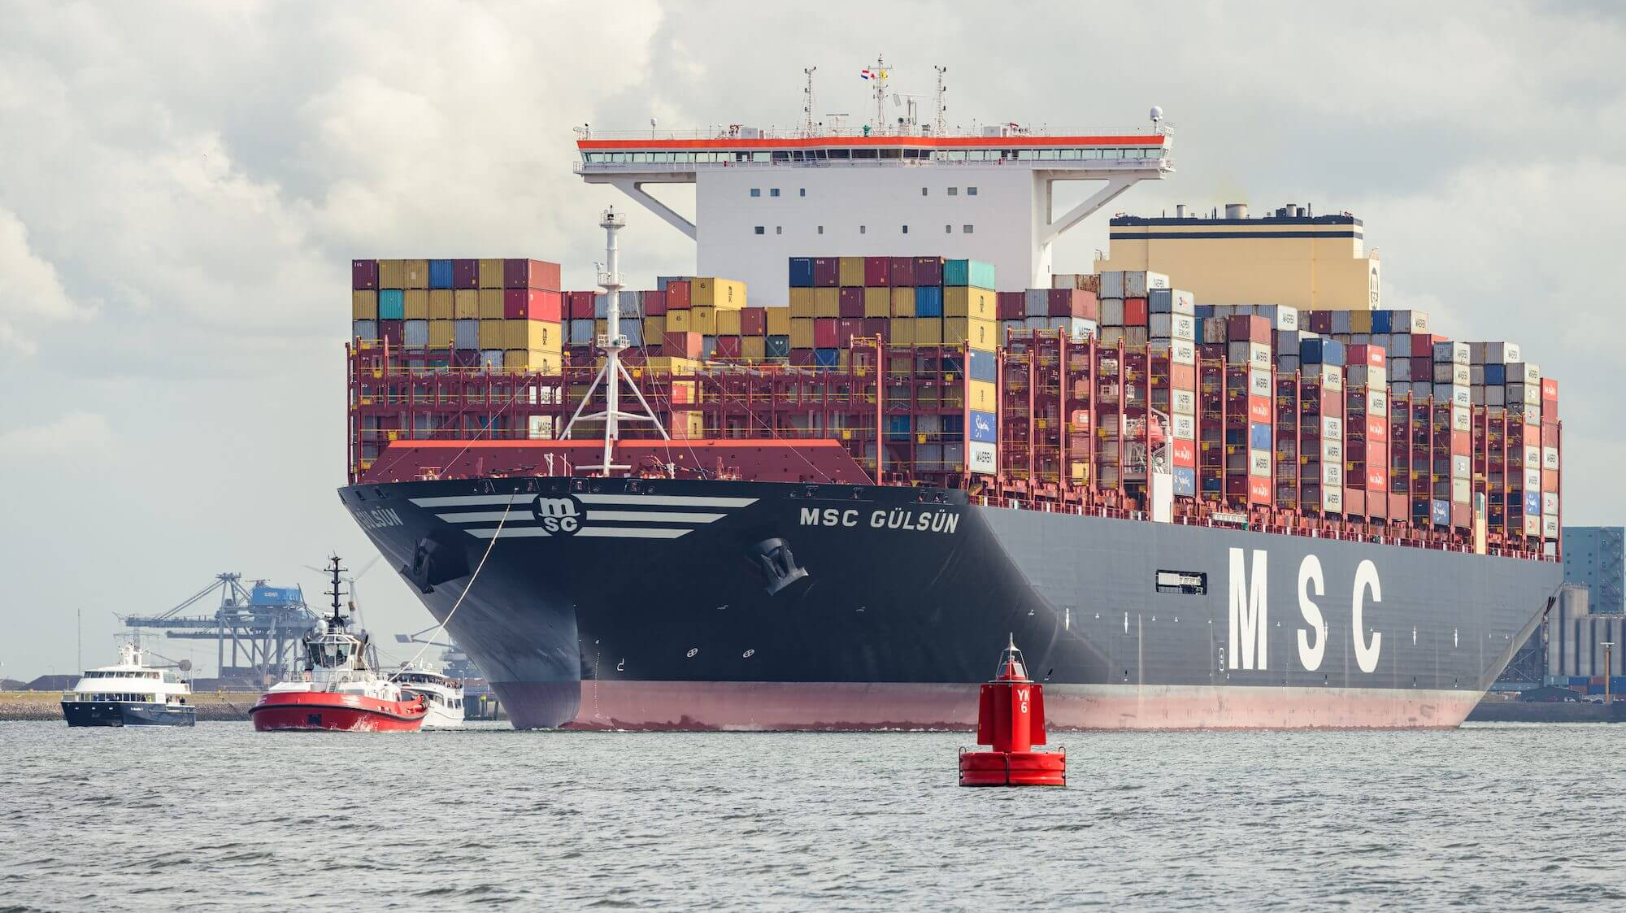

Slide 14


AV Trucks
https://kodiak.ai/?gclid=CjwKCAjw_YShBhAiEiwAMomsEAFMEEMQh619kuR2L2NcZCQlt1NpQKwg_UsWFeQAM-yGvzfEW-MElRoCeSkQAvD_BwE

Slide 15

Global Value Chains in Action

Slide 16

NAFTA and the Auto Supply Chain
Black, Diamond, and Merrill, “One Tiny Widget’s Dizzying Journey Shows Just How Critical Nafta Has Become,” Bloomberg, February 2, 2017.

Slide 17

NAFTA and the Auto Supply Chain
Black, Diamond, and Merrill, “One Tiny Widget’s Dizzying Journey Shows Just How Critical Nafta Has Become,” Bloomberg, February 2, 2017.

Slide 18

NAFTA and the Auto Supply Chain
Black, Diamond, and Merrill, “One Tiny Widget’s Dizzying Journey Shows Just How Critical Nafta Has Become,” Bloomberg, February 2, 2017.

Slide 19

NAFTA and the Auto Supply Chain
Black, Diamond, and Merrill, “One Tiny Widget’s Dizzying Journey Shows Just How Critical Nafta Has Become,” Bloomberg, February 2, 2017.

Slide 20

NAFTA and the Auto Supply Chain
Black, Diamond, and Merrill, “One Tiny Widget’s Dizzying Journey Shows Just How Critical Nafta Has Become,” Bloomberg, February 2, 2017.

Slide 21

NAFTA and the Auto Supply Chain
Black, Diamond, and Merrill, “One Tiny Widget’s Dizzying Journey Shows Just How Critical Nafta Has Become,” Bloomberg, February 2, 2017.

Slide 22

Growth of Global Value Chains, 1970-2015
Source: World Development Report 2020
Notes:
World Bank
https://www.worldbank.org/en/publication/wdr20

Slide 23

Countries mentioned:
China
France
Italy
Japan
Malaysia
Singapore
Spain
Vietnam
Source: World Development Report 2020
Notes:
World Bank
https://www.worldbank.org/en/publication/wdr20

Slide 24
Supply Chains
Example: The iPhone assembled in China from parts:
Part | Come from
﻿Accelerometers | ﻿Germany, the US, South Korea, China, Japan, and Taiwan.
﻿Audio chips | ﻿US, UK, China, South Korea, Taiwan, Japan, and Singapore.
﻿Batteries | ﻿Samsung (South Korea), which has factories in eighty countries.
﻿Cameras | ﻿Qualcomm (US) and Sony (Japan), both with plants in many countries
﻿Chips ﻿for 3G/4G/LTE networking | ﻿Qualcomm (US)
﻿Compasses | ﻿AKM Semiconductor (Japan) with plants in the US, France, England, China, South Korea, and Taiwan.
﻿Glass screen | ﻿Corning (US) with plants in twenty-six countries.
﻿Gyroscopes | Switzerland
… and many more
Source: Krueger 2020, International Trade (What Everyone Needs to Know), p. 254
Notes:
Krueger, Anne O., International Trade (What Everyone Needs to Know) (p. 254). Oxford University Press, 2020

Slide 25

Source: World Bank
Notes:
World Bank
https://www.worldbank.org/en/publication/wdr2020

Slide 26
Pros and Cons of Globalization
Pros and Cons of Globalization
  Gains from Trade
    Theory of Comparative Advantage
    Other Sources of Gain from Trade
  Costs of Trade

Slide 27
Gains from Trade
Theory of Comparative Advantage

Slide 28
Comparative Advantage
The Theory of Comparative Advantage says:
  Countries can, by producing
    More than they need of what they do relatively best, and
    Less than they need of what they do relatively worst
  And exporting the extra to other countries in exchange for what they need
  All countries can
    Get more of everything if that’s what they want, and
    Gain from trade
Illustration with a graph of just 2 countries & 2 goods
  (I’m eager to know whether this helps you understand.)

Slide 29
Comparative Advantage
If US & UK differ in what they can produce…
Cloth
US
Cloth
UK
Food
Food

Slide 30
Comparative Advantage
… Without trade, their consumption will also differ…
Cloth
US
Cloth
UK
Without trade
Consumption =
Production
C^{B}=P^{B}
C^{A}=P^{A}
Food
Food

Slide 31
Comparative Advantage
… With free trade, they specialize in what they do best…
Cloth
US
Cloth
UK
P^{B}
Free Trade
Production
C^{B}=P^{B}
C^{A}=P^{A}
P^{A}
Food
Food

Slide 32
Comparative Advantage
… And can consume more by trading.
Cloth
US
Cloth
UK
P^{B}
Trade
Free Trade
Consumption
C^{A}
C^{B}=P^{B}
Trade
C^{A}=P^{A}
P^{A}
Food
Food

Slide 33
Comparative Advantage
Thus countries both Gain from Trade
Cloth
US
Cloth
UK
P^{B}
Trade
Gain from Trade
C^{A}
C^{B}=P^{B}
Trade
C^{A}=P^{A}
P^{A}
Food
Food

Slide 34
Generality of Comparative Advantage
The Theory of Comparative Advantage requires:
  “Perfect competition” (i.e., all buyers and sellers are very small)
  Absence of market “distortions” (externalities, etc.)
    i.e., reasons why supplies and demands don’t reflect true costs and benefits
The Theory of Comparative Advantage does not require:
  Any limit on numbers of goods, factors, and countries
  That only final goods are traded (thus consistent with supply chains)
  That factors (labor, capital) be immobile between countries
    (However, the gains from trade then accrue to countries including their mobile-factor owners.)

Slide 35
Reality of Comparative Advantage
But note:
  Nothing in the theory says that everyone in each country gains
  Opening to trade requires
    Some industries to shrink or disappear while others expand
    Firms and workers in shrinking industries
      Certainly lose during the transition
      May be permanently worse off
    In example, losers are producers of
      Cloth in US
      Food in UK
Cloth
US
Cloth
UK
P^{B}
C^{B}=P^{B}
C^{A}=P^{A}
P^{A}
Food
Food

Slide 36
Gains from Trade
Other Sources of Gain from Trade

Slide 37
Other sources of Gain from Trade
Productivity (most productive firms expand and export)
Returns to scale (small countries can support larger firms)
Competition (monopolies in small countries lose market power)
Variety (buyers can access more choices)
Supply chains (firms can source parts from cheapest or best sources)
  (That’s really just the above, but within industries and firms.)
Technology (producers get access foreign technologies)

Slide 38
Costs of Trade

Slide 39
But there are Costs
Economic:
  When trade expands (or contracts)
    Some firms lose market share or shut down
    Other firms supplying inputs shrink of shut down
    Workers in both lose jobs
    Their communities lose customers
  Macroeconomic cost: Vulnerability to foreign recession/inflation
  Dependence on other countries willingness to trade
  Vulnerability to trade disruption
    Crisis induced (earthquake, flood, disease)
    Policy induced (sanctions, tariffs, export bans)
Non-economic
  Loss of cultural differences
  Spread of disease

Slide 40
Trade Policies that Affect Globalization
Policies that Encourage It
  Tariff Reductions
  Trade Agreements
  Other
Policies that Discourage It
  Tariffs
  Trade War

Slide 41
Policies that Encourage Globalization

Slide 42
Tariff Reductions

Slide 43

Source: Economist
Notes:
From an Economist “Barriers to Entry” article

Slide 44

Source: Quartz 2018
Notes:
Quartz, Kopf 2018
https://qz.com/1230399/a-history-of-tariffs-us-protectionism-in-one-230-year-chart/

Slide 45
Trade Agreements

Slide 46
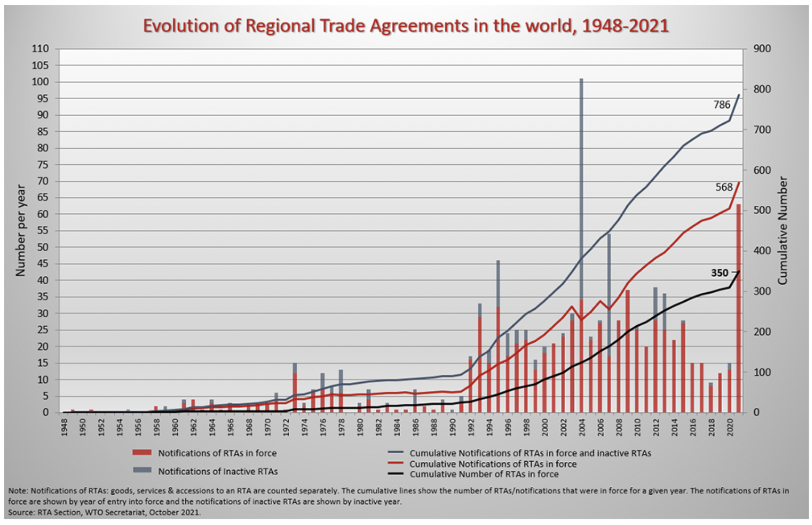
Source: WTO
Notes:
WTO
https://www.wto.org/english/tratop_e/region_e/region_e.htm#facts

Slide 47
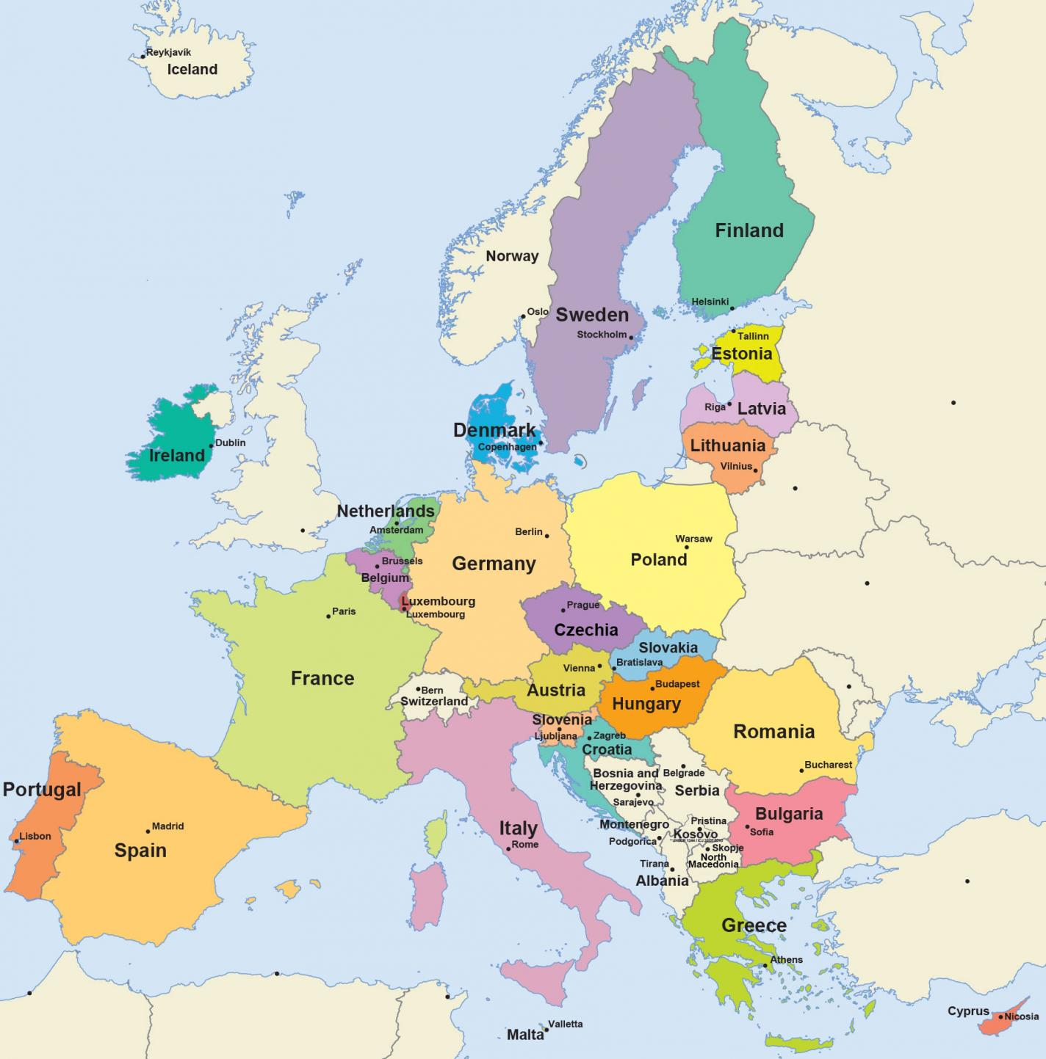
European Union
Source: Europa.eu
Notes:
http://europa.eu/european-union/about-eu/money/euro_en

Slide 48
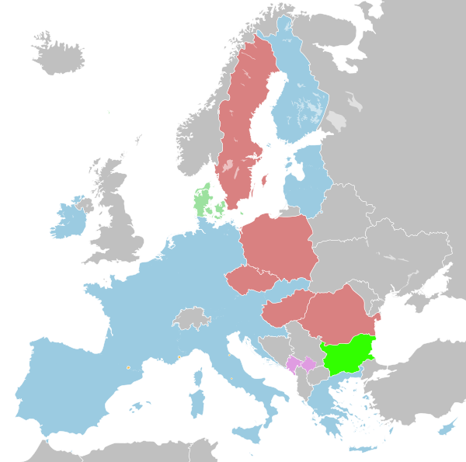
Eurozone
Source: Europa.eu
Notes:
http://europa.eu/european-union/about-eu/money/euro_en

Slide 49

NAFTA (now USMCA)

Slide 50

MERCOSUR

Slide 51

CPTPP
=
Trans-Pacific Partnership minus US
(US is working to re-engage)

Slide 52
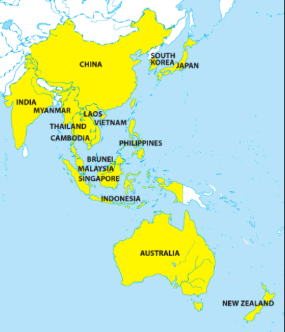
RCEP
=
Regional Comprehensive Economic Partnership
Notes:
China Briefing 2012
https://www.china-briefing.com/news/china-to-join-rcep-creating-massive-free-trade-area-with-asean-india-and-japan/

Slide 53
Other Policies to Encourage Globalization
IMF/World Bank
  Policy advice to open markets (the ”Washington Consensus”)
  Loans to countries conditional on
    Reducing trade barriers
    Permitting capital flows
GATT/WTO (World Trade Organization) [More on this later]
  Negotiate reciprocal trade liberalization
  Settlement of trade disputes (usually about interfering with trade)
Bilateral Investment Treaties
  Better treatment of multinational corporations

Slide 54
Policies that Discourage Globalization

Slide 55
Trump’s Tariffs and Trade War

Slide 56

Source: Flaan & Pierce 2020
Notes:
Flaan and Pierce 2020
https://www.federalreserve.gov/econres/feds/files/2019086pap.pdf

Slide 57

Source: Flaan & Pierce 2020
Notes:
Flaan and Pierce 2020
https://www.federalreserve.gov/econres/feds/files/2019086pap.pdf

Slide 58

Source: CNBC.com
Notes:
SEPTEMBER 18, 2019 | Yen Nee Lee, CNBC.com
http://nbr.com/2019/09/18/these-4-charts-show-how-us-china-trade-has-changed-during-the-tariff-dispute/

Slide 59

Phase One Agreement Reductions Jan 2020
US tariffs on China
Agriculture
Industrial
China tariffs on US
Agriculture
Industrial
Source: Zheng et al. Oct 2021
Notes:
Zheng, Jian, Shudong Zhou, Xingzi Li, Antonio Domingos Padula, Will Martin, “Effects of Eliminating the US-China Trade War Tariffs,” 27 October 2021

Slide 60
Effects of Tariffs

Slide 61
Effects of a tariff
A tariff is a tax on imports. It causes:
  A rise in the price of the imported good in the importing country
  A fall in the price of the imported good in the exporting country
  The quantity imported to fall
  The revenue of the tariff-levying government to rise
Almost always: the rise at home is much larger than the fall abroad
  That’s especially true if importing country is small
  But it’s also true if importing country is large, such as U.S.
  Example: Trump’s tariffs caused US prices to rise, with hardly any perceptible fall in prices abroad.

Slide 62
Effects of a tariff
The rise in price in the importing country causes
  A rise in price of competing goods produced there
  Benefits to those producers
  Harm to buyers of both the import and the competing goods
    Including producers that use the higher-priced goods as inputs
      Their prices also rise, hurting their buyers
  Employment changes
    Increase in the protected industry
    Decrease in industries that use imports as inputs
  Example: Trump’s 25% tariff on steel
    Helps US steel firms and their workers
    Hurts US auto firms and workers
      and many other industries that use steel

Slide 63
Effects of a tariff
The fall in price in the exporting country causes
  Harm to sellers there
  Benefit to buyers there
  Shift of sales to other countries
If the tariff is on exports from only one country (e.g, China)
  Buyers shift to imports from other, more costly, countries (e.g., Vietnam)

Slide 64
Arguments for and against tariffs
If economists are so opposed to tariffs, why are they used?
Arguments for protection
  Many have been used, both past and present
  See the list in A. Deardorffs’ Glossary of International Economics (next)

Slide 65

Arguments for tariffs
National security
Government Revenue
Strategic trade policy
Distribution
Infant Industry
Source: Deardorffs’ Glossary of International Economics

Slide 66
Arguments against tariffs
Arguments against tariffs
  Economic gains from trade (see above)
  Tariffs prompt retaliation
  Some valid arguments for tariffs depend on information that is either
    Unavailable, or
    Available only from the protected industry
  Even when net beneficial, tariffs are politically hard to remove
  Enables transfer of technology
  Reduces likelihood of war

Slide 67
The Role of Trade Agreements
Countries have negotiated trade agreements throughout history
  At least back to the 1500’s between the Ottoman Empire and the powers of Europe
  The first “free trade agreement” (FTA) was between Britain and France in 1860, soon followed by many more
    Removed tariffs on trade with each other
  US used “reciprocal trade agreements” starting in 1934 to reduce tariffs and dig out of the Great Depression
  US led negotiation of multilateral agreements via
    GATT (General Agreement on Tariffs and Trade) 1948
    WTO (World Trade Organization) 1995

Slide 68
The Role of Trade Agreements
Trade Agreements (both WTO & FTAs)
  Promote trade by
    Reducing tariffs
    Blocking policies that discriminate against imports
  But they also do much else, mostly to serve business interests:
    Permit anti-dumping duties to deter competition
    Protect intellectual property (patents, etc.)
    Allow investor action against governments

Slide 69
The Role of Trade Agreements
WTO
  164 member countries
  Includes
    China since 2001
    Russia since 2012
    Not Iran, N. Korea
  Headquarters Geneva, Switzerland

Slide 70


Slide 71



Slide 72
The Role of Trade Agreements
The WTO has
  Three Parts:
    GATT (Still exists, as largest part of WTO)
      limits tariffs
    GATS = General Agreement on Trade in Services
    TRIPs Agreement = Trade Related aspects of Intellectual Property Rights
  Two Basic Principles
    Most Favored Nation
    National Treatment

Slide 73
The Role of Trade Agreements
The WTO’s Main Functions
  Negotiation of reduced trade barriers
    Tariffs (GATT did this well; WTO not)
    Removal of other barriers
  Dispute settlement
    Countries bring cases against others
    WTO “panels” and “Appellate Body” decide

Slide 74
The Role of Trade Agreements
WTO Dispute Settlement
  There have been 609 cases initiated since 1995 (as of 1/30/22)
  About 90% have been decided in favor of the complainant, both by (132) and against US (168)
  The mechanism has been unable to decide cases since December 10, 2019 when
    President Trump blocked appointments to Appellate Body
    President Biden has not changed this
Notes:
Case counts as of 2/2/22
https://www.wto.org/english/tratop_e/dispu_e/dispu_by_country_e.htm

Slide 75
Effects of the Pandemic
Effects of the Pandemic on Economies
  Travel halted
  Stock markets fell but came back strongly
  Factories shut down
  Supply chains were interrupted
  Trade plummeted but came back

Slide 76
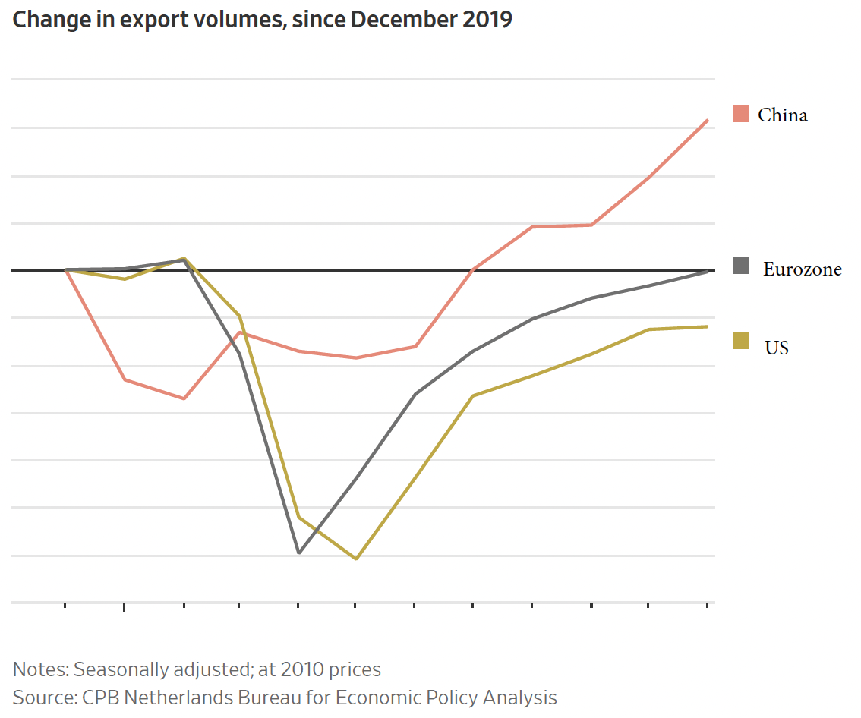
Source: Hannon, WSJ, Feb 25, 2021
Notes:
Hannon, Paul, "Global Trade Roars Back From Depths of Covid-19 Pandemic", Wall Street Journal,, February 25, 2021.

Slide 77
The Pandemic and Globalization
Trade and Covid-19
  Globalization helped it spread
  Trade in PPE and medical supplies helped to fight it
  Trade in vaccines is essential globally
  Trade policies have often interfered

Slide 78
The War and Globalization
Trade and the War in Ukraine
  War related trade
  Non-war related trade
    Consumer goods
      Oil and gas
      Food supply and prices

Slide 79
Globalization’s Future?

Slide 80
Globalization’s Future?
Will trade, travel, etc. come back?
  Yes.
Will it reach the previous trend
  Most likely
  It didn’t after the financial crisis
Will attitudes change?
  Yes.
  Firm’s will try to limit exposure
  Consumers will learn to live differently
Will economists’ views of globalization change?
  I think so.
    We still think globalization is good,
    But we’re learning that it needs to include greater protections for those who are hurt.

Slide 81


International Institutions: Alan Deardorff
Next Week

Slide 82
Thank you!
Any Questions?
www.NEEDEcon.org
Arkadiuz Mironko
amironko@iu.edu
Contact NEED: info@NEEDEcon.org
Submit a testimonial: www.NEEDEcon.org/testimonials.php
Support NEED: www.NEEDEcon.org/donate.php

